Slide 1

INTERVENTION MODELING
A TIME SERIES ANALYSIS OF A PRODUCT SHIPMENTS
MTH 544: Time Series
Instructor: Dr. Maher Qumsiyeh
Term: Spring 2021
Student Name: Serge Alhalbi

Slide 2
Outline
INTRODUCTION
ANALYSIS
Conclusion
DATA VISUALIZATION
MODELING DATA BEFORE INTERVENTION
PRE-DIFFERENCING
STATIONARITY
DETERMINING THE MODEL
INTERVENTIONS MODELING
FINAL MODEL & FORECASTING

Slide 3
Data Visualization
Weekly Shipments of a product (per unit)
Time series data of sample size n = 100
Two interventions of different types occurring

Slide 4
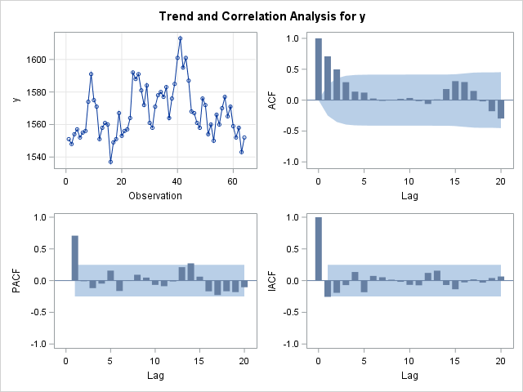
Modeling Data Before Intervention
Pre-Intervention: (First 64 Observations Used)
Differencing
No differencing needed
Series Stationarity
Constant mean and constant variance
Both SAC and SPAC cut off after a certain lag or die fast

Slide 5
Potential Models
ARIMA(0,0,2)
ARIMA(1,0,0)
ARIMA(1,0,2)

Slide 6
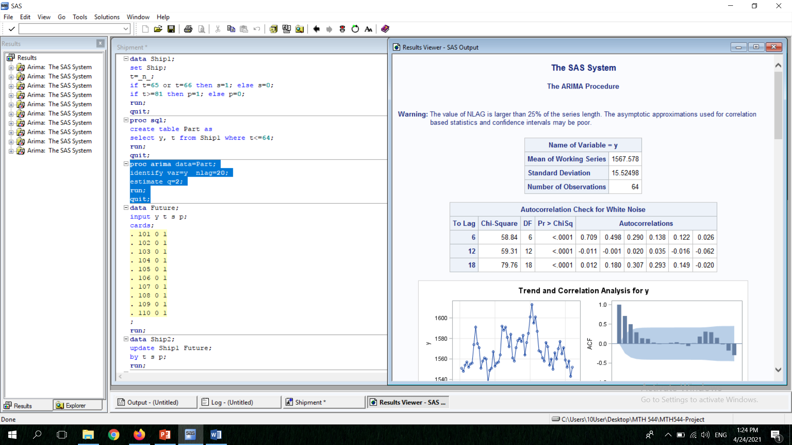
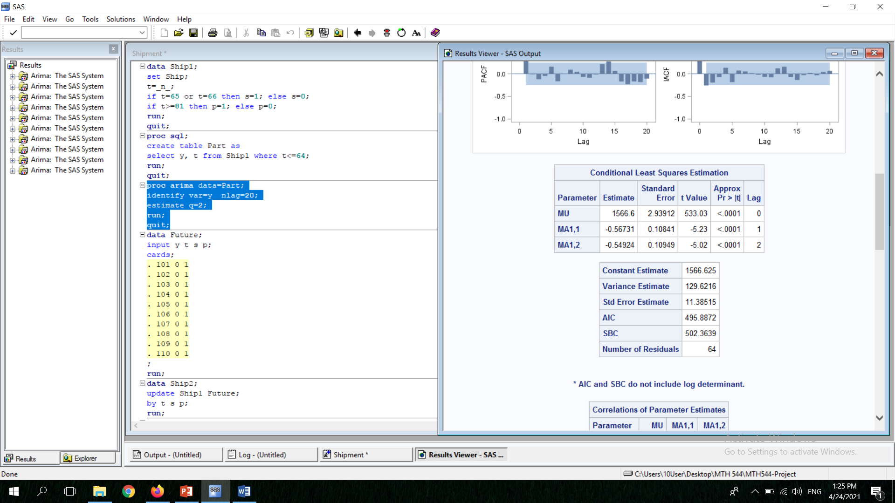
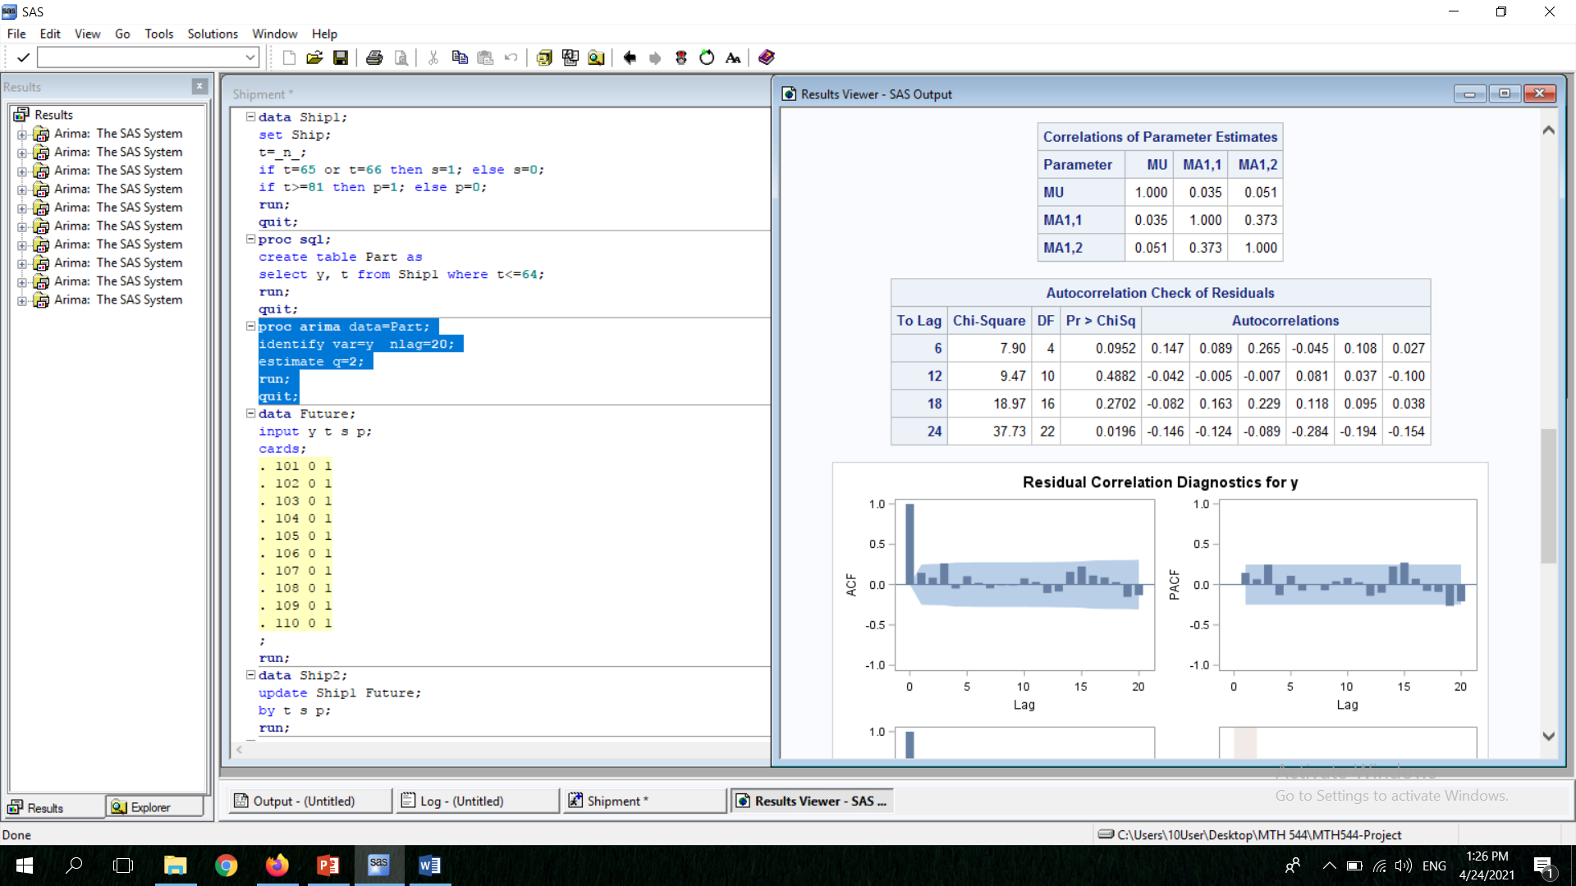
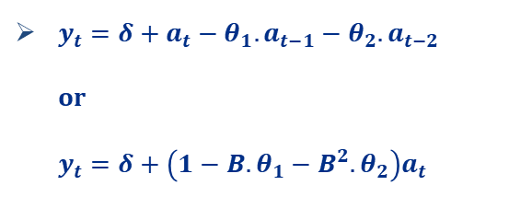
Potential Model (I)
Model:
ARIMA(0,0,2)
$y_{t}=δ+a_{t}−θ_{1}.a_{t−1}−θ_{2}.a_{t−2}$ or $y_{t}=δ+\left(1−B.θ_{1}−B^{2}.θ_{2}\right)a_{t}$
Four criteria to check
Residuals are auto correlated

Slide 7
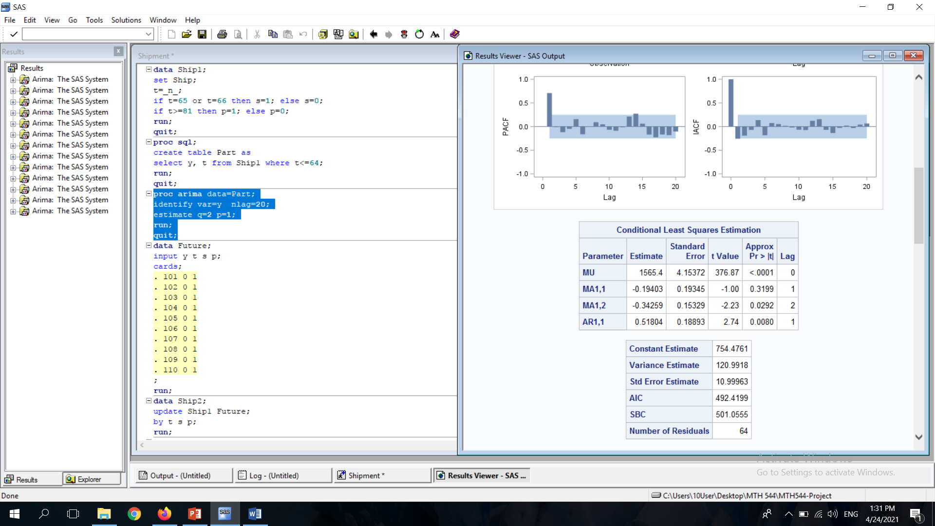
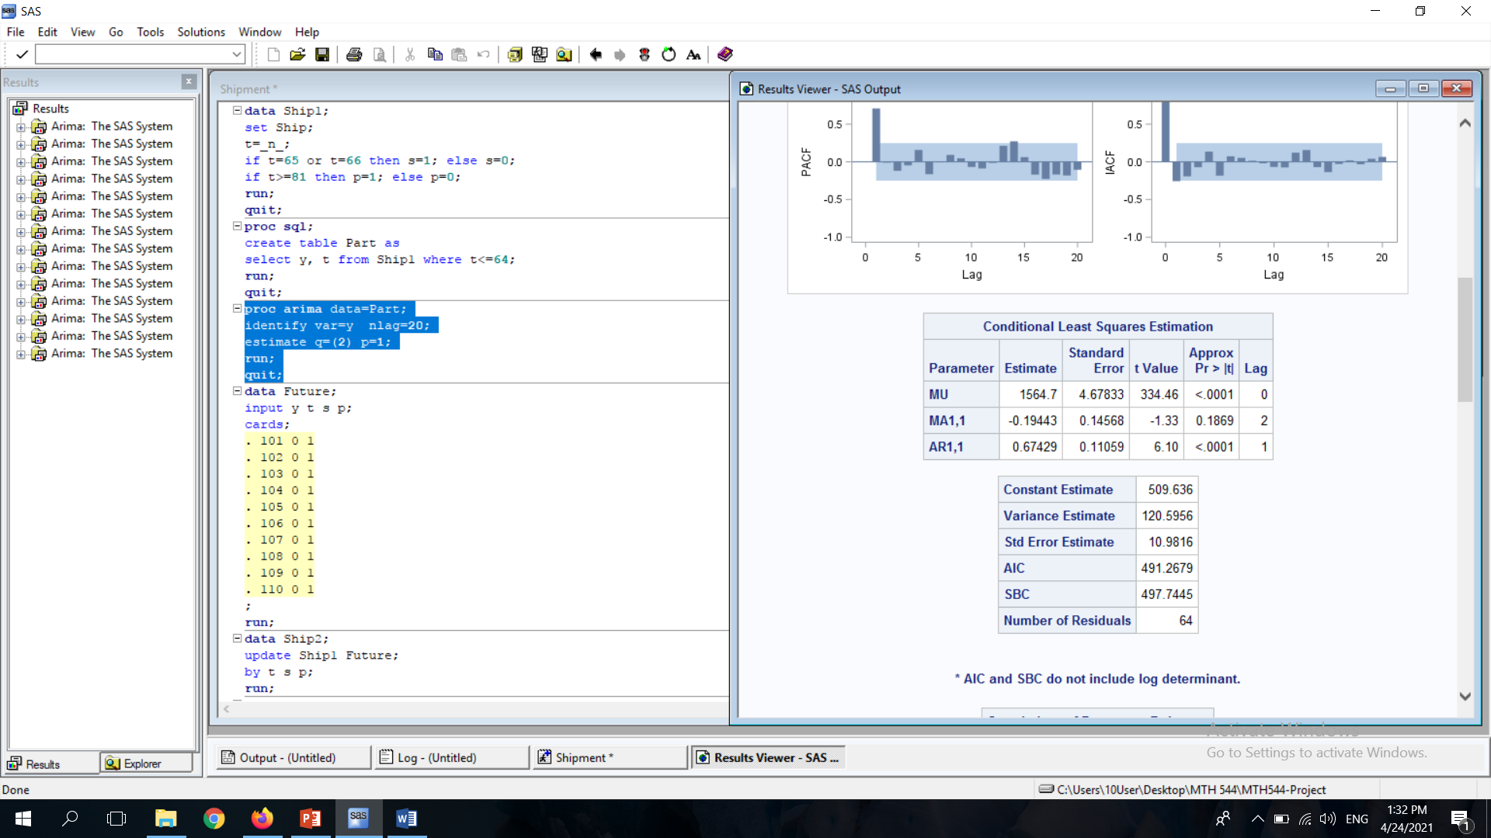
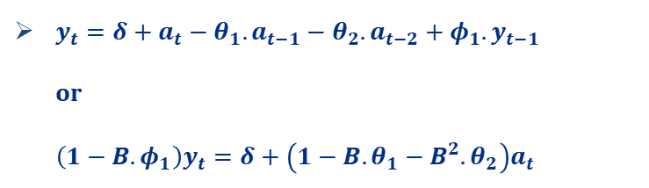
Potential Pre-Model (II)
Model:
ARIMA(1,0,2)
$y_{t}=δ+a_{t}−θ_{1}.a_{t−1}−θ_{2}.a_{t−2}+φ_{1}.y_{t−1}$ or ${\left(1−B.φ_{1}\right)y}_{t}=δ+\left(1−B.θ_{1}−B^{2}.θ_{2}\right)a_{t}$
Four criteria to check
Parameters are insignificant

Slide 8
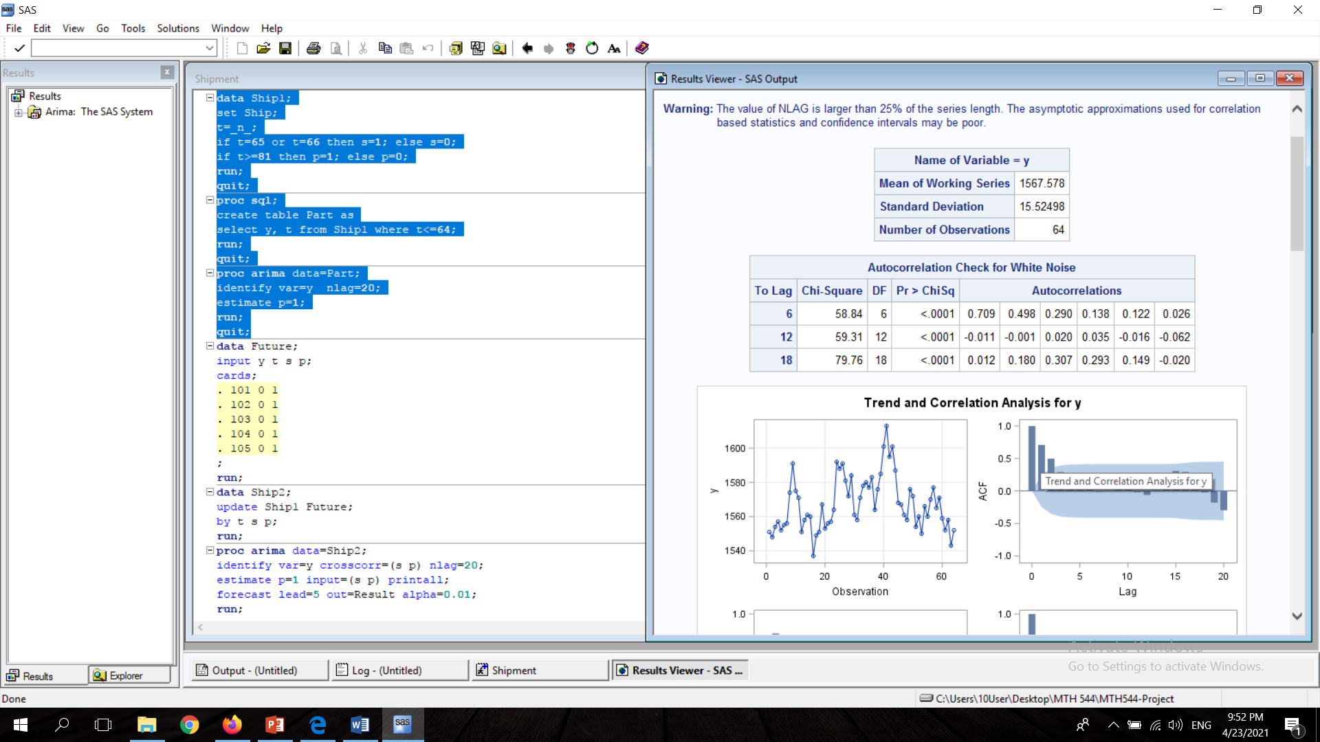
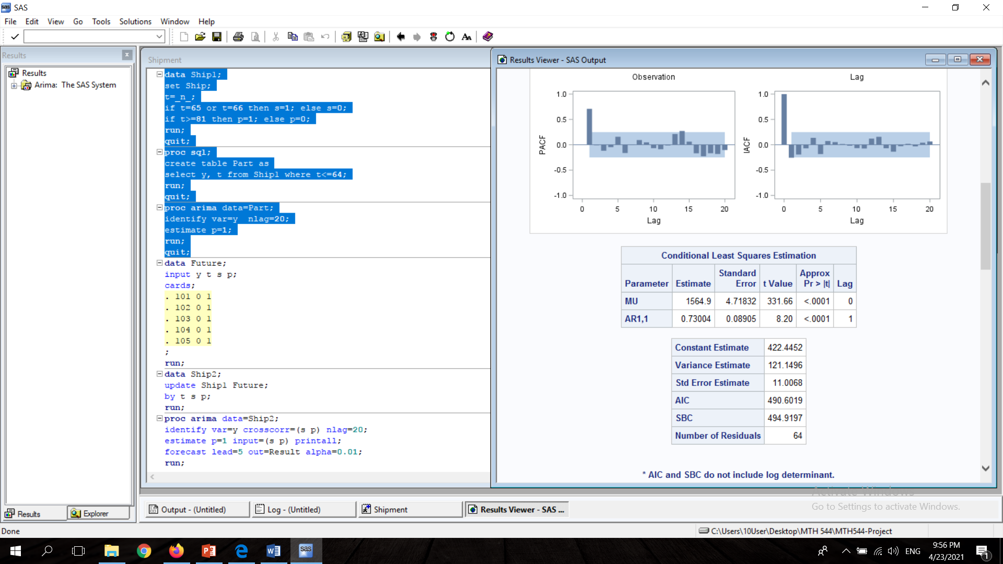
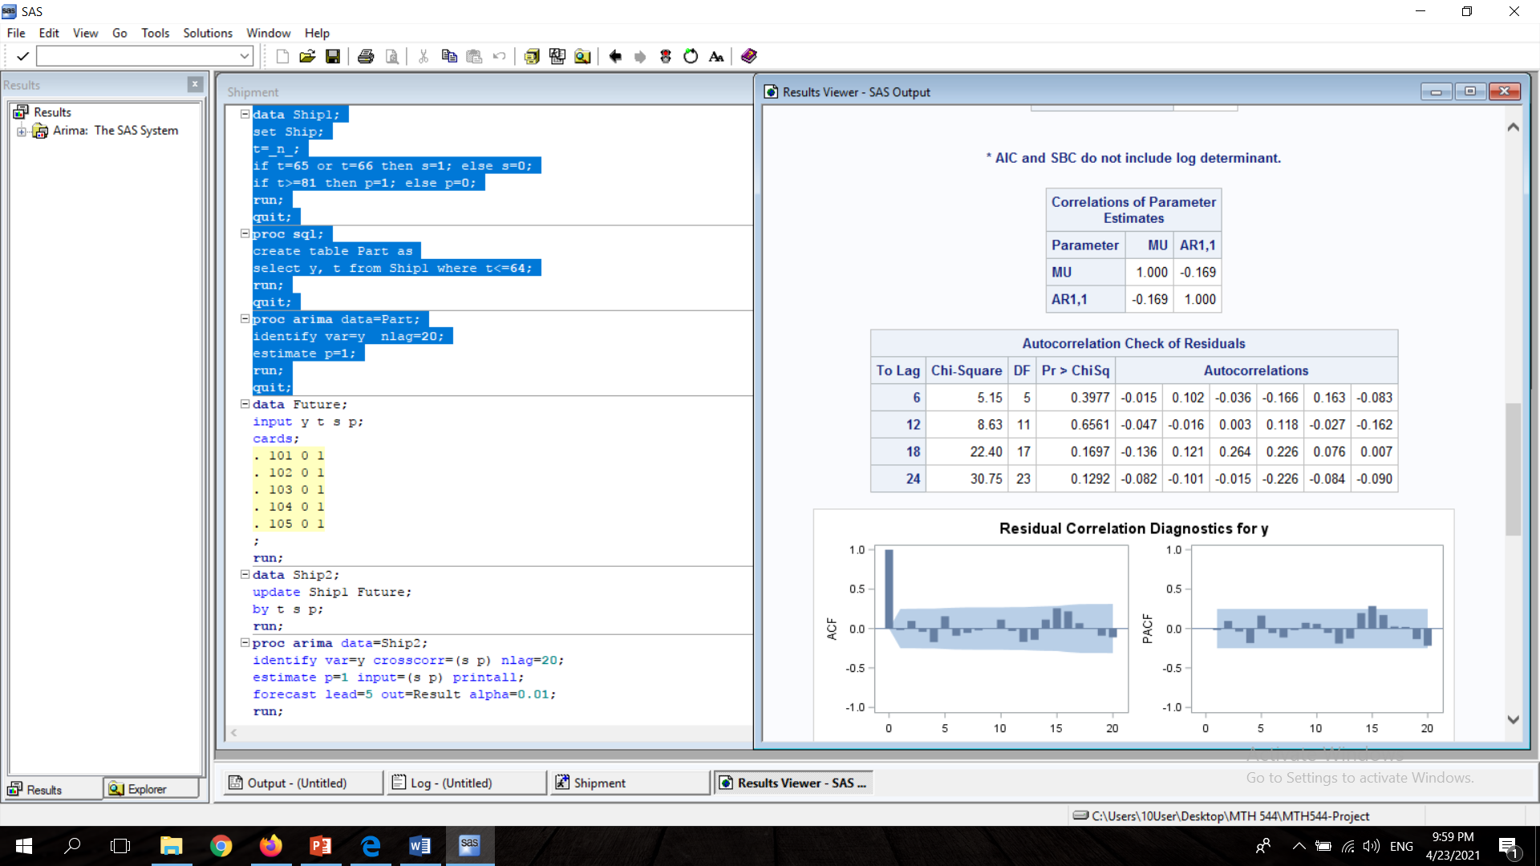
Best Model Before The Interventions
Model:
Conditions:
ARIMA(1,0,2)
$y_{t}=δ+φ_{1}.y_{t−1}+a_{t}$ or (1-B.$φ_{1}$)$y_{t}=δ+a_{t}$
Four criteria to check
Stationarity: $\left|{\hat{φ}}_{1}\right|<1$
Invertability: None

Slide 9
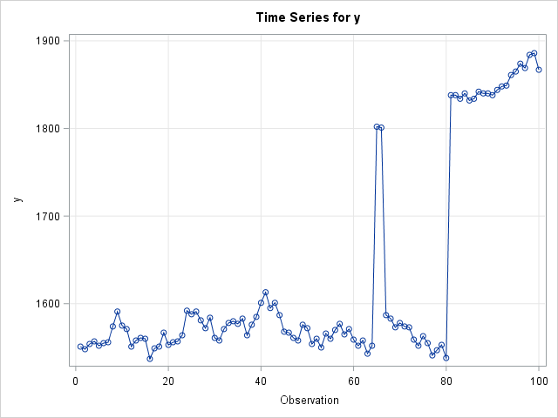
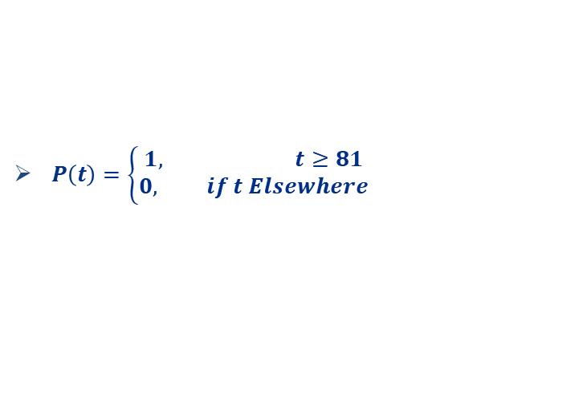
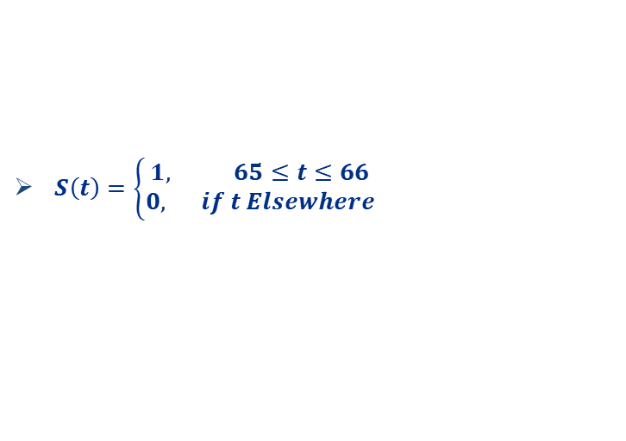
Interventions Modeling
Intervention 1:
Intervention 2:
Regression model describing the interventions:
$S\left(t\right)=\left\{\begin{aligned}1, 65≤t≤66 \\ 0, if t Elsewhere\end{aligned}\right.$
$P\left(t\right)=\left\{\begin{aligned}1, t≥81 \\ 0, if t Elsewhere\end{aligned}\right.$
$y_{t}=C_{1}.S_{t}+C_{2}.P_{t}+ε_{t}$

Slide 10
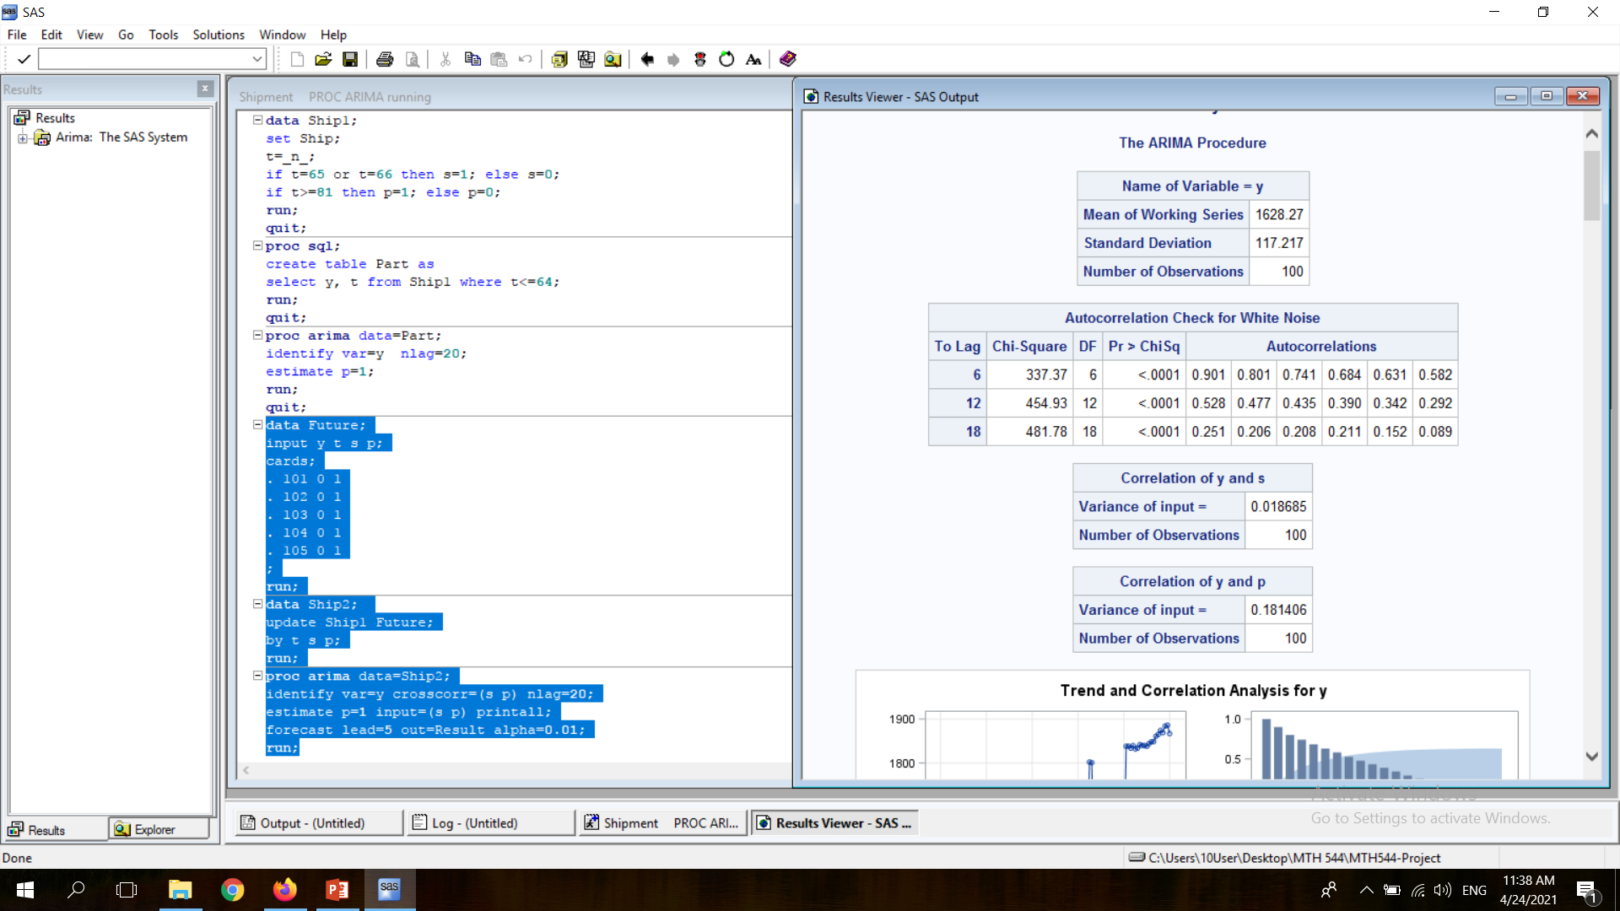
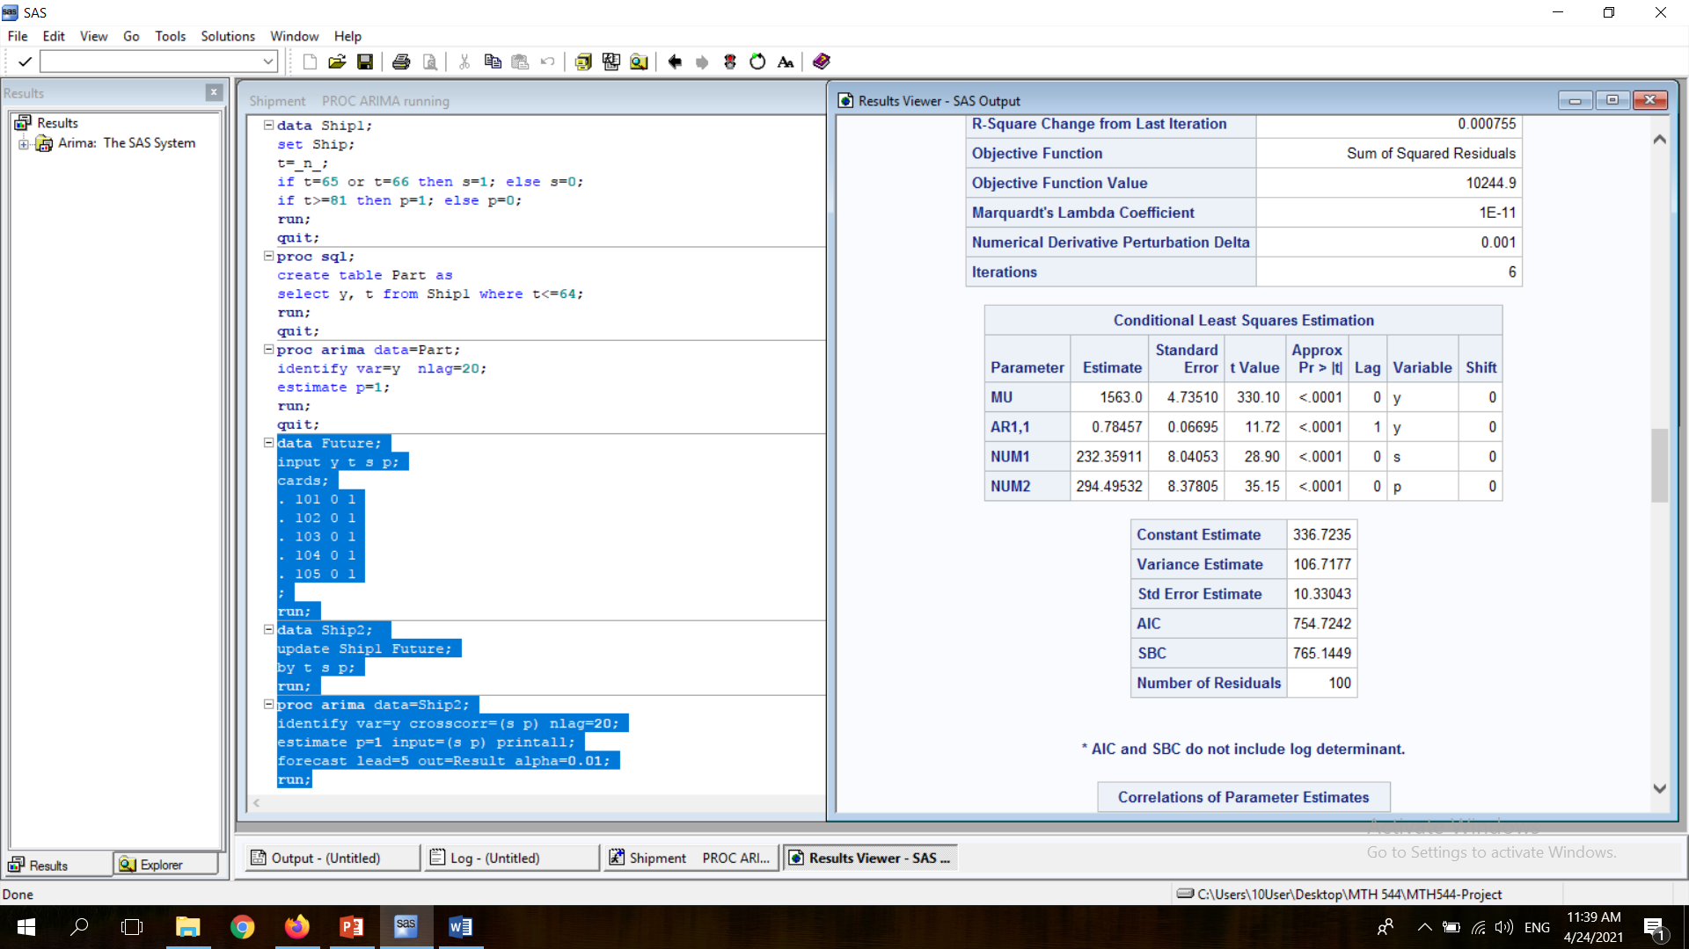
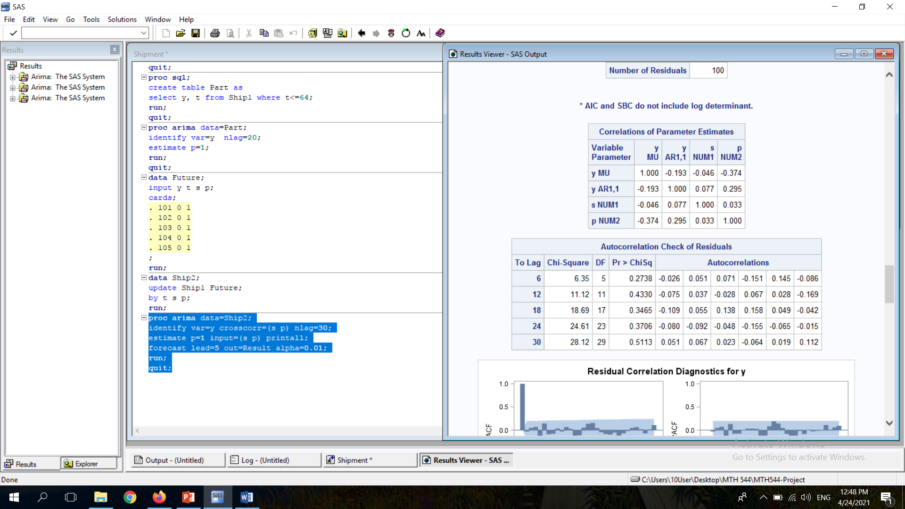

Final Model
Model with interventions:
$y_{t}=δ+C_{1}.S_{t}+C_{2}.P_{t}+φ_{1}.y_{t−1}+a_{t}$
$C_{1}$ and $C_{2}$ are both positive => Increasing
Four criteria to check

Slide 11
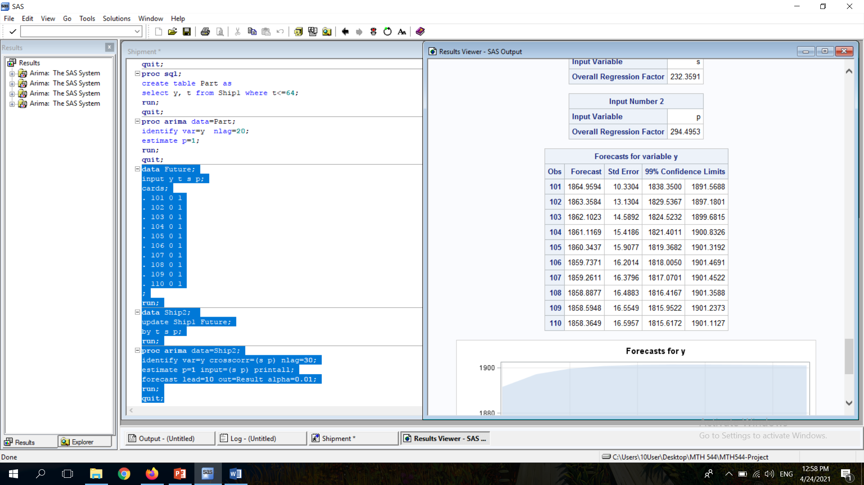
Forecasting
Forecasting future values:
Week 101 to 110 (10 values)
99% Confidence interval for the y’s
Small confidence interval lengths of the forecast

Slide 12
Model Accuracy

Slide 13
Conclusion
Model is fit and accurate
Unknown cause of the interventions
Sample size is small; no data validation
Questions / Answers

Slide 14
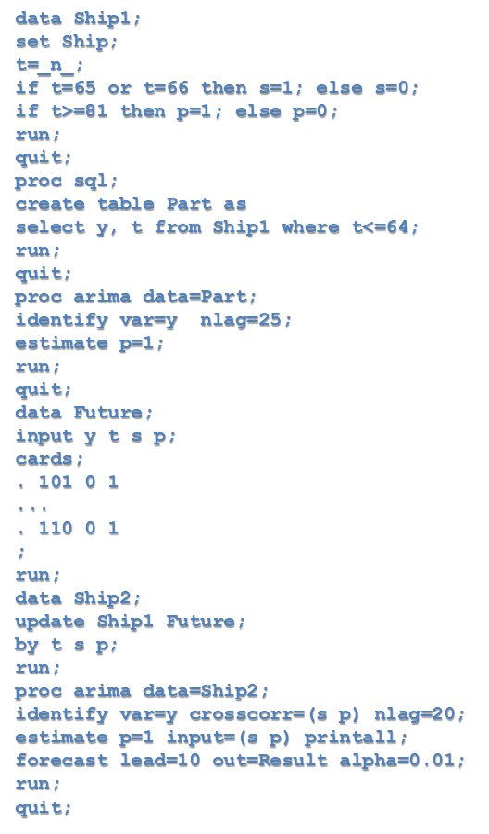
References
Data Set:
Program: SAS and Excel
Source: https://www.kaggle.com/datasets
Weekly Shipments of a Product in Unit
1551 | 1571 | 1556 | 1558 | 1613 | 1554 | 1552 | 1574 | 1838 | 1844
1548 | 1551 | 1557 | 1571 | 1595 | 1560 | 1558 | 1573 | 1838 | 1848
1554 | 1558 | 1564 | 1578 | 1601 | 1550 | 1543 | 1559 | 1834 | 1849
1557 | 1561 | 1592 | 1580 | 1587 | 1566 | 1552 | 1552 | 1840 | 1861
1552 | 1560 | 1588 | 1577 | 1568 | 1560 | 1802 | 1563 | 1832 | 1865
1555 | 1537 | 1591 | 1583 | 1567 | 1570 | 1801 | 1555 | 1834 | 1874
1556 | 1549 | 1581 | 1564 | 1561 | 1577 | 1587 | 1541 | 1842 | 1869
1574 | 1551 | 1572 | 1576 | 1558 | 1565 | 1583 | 1547 | 1840 | 1884
1591 | 1567 | 1584 | 1585 | 1576 | 1571 | 1573 | 1553 | 1840 | 1886
1575 | 1553 | 1561 | 1601 | 1572 | 1559 | 1578 | 1538 | 1838 | 1867

Slide 15
THANK YOU!

